Slide 1

Inventory Data Analysis
Presented by Emaad Ur Rehman

Slide 2




Procurement Operations Overview
$995,391.56 Total Spends
on procurement across 90 transactions.
32 Active Suppliers
serving 85 unique materials.
2,000+ Inventory Movements
in two months (Feb-Mar 2025).
4 Integrated Tables
with 13 movement types analyzed.

Slide 3


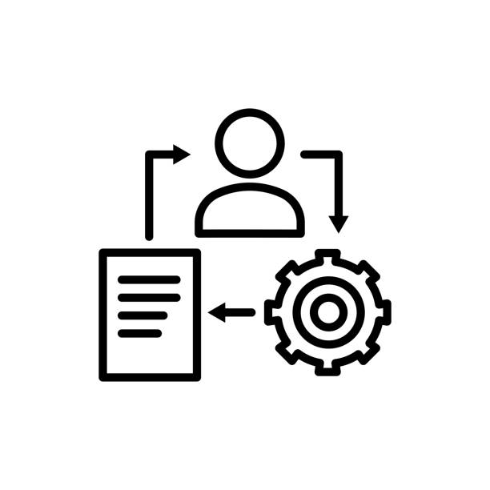

Current Challenges Identified
Limited visibility into procurement patterns.
Manual reporting processes.
Fragmented data across multiple systems.
Reactive rather than strategic decisions.

Slide 4
Hidden Risks in Procurement Operations
High-Risk Concentrations
35.3% spend concentrated with single supplier ($351,270) leading to supplier risk.
Top material represents 31.9% of total spend ($317,168).
Material Group 300YM accounts for 52.7% of procurement.
Quality & Operational Issues
10% Order Correction Rate across all procurement transactions.
21.9% of suppliers handling complex materials requiring specification accuracy (7 out of 32).
74.9% spending in February only indicating extreme seasonal flux.
One supplier with 100% order complexity.

Slide 5
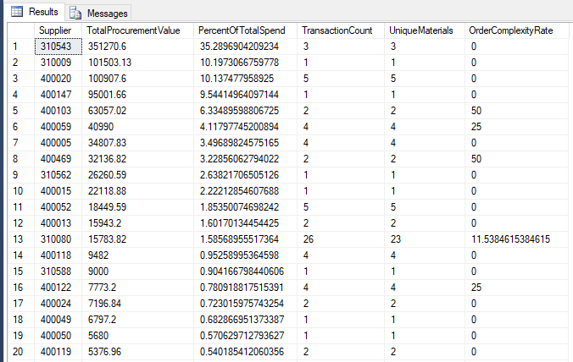
Quality & Operational Issues
Supplier concentration analysis showing top 20 suppliers.

Slide 6
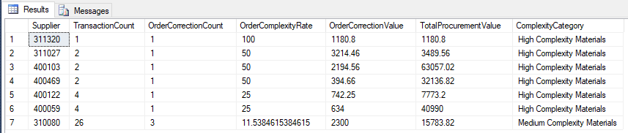
Quality & Operational Issues
Specification complexity analysis showing order correction rates by supplier.

Slide 7
Four Strategic SQL Views for Complete Procurement Intelligence
Four Strategic SQL Views Created
Procurement Performance View - Transaction-level spend and price analysis.
Supplier Performance Dashboard - Quality metrics and concentration analysis.
Material Category Analysis - Category spend patterns and diversification.
Inventory Movement Analysis - Complete operational flow visibility.
Technical Foundation
Real-time data processing from existing systems.
Automated calculation of key performance indicators.
Standardized reporting across all procurement activities.
Foundation for advanced analytics and dashboards.

Slide 8
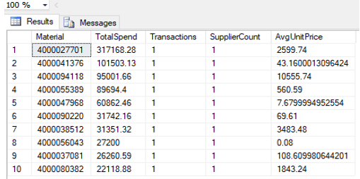
Turning Data into Strategic Intelligence
Top Spending Analysis
Material-level spend breakdown identifying cost drivers.
Unit price analysis across all materials.
Supplier count per material showing diversification opportunities.

Slide 9
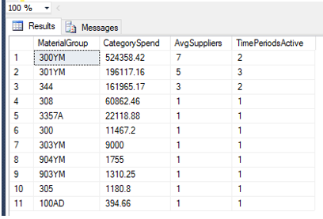
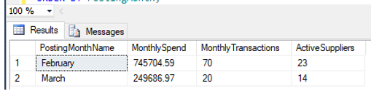
Category & Movement Analysis
Material category spending by group.
Monthly spending patterns and seasonality.

Slide 10
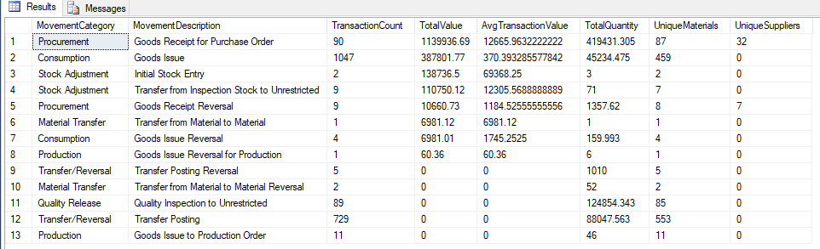
Category & Movement Analysis
Complete inventory movement type analysis.

Slide 11


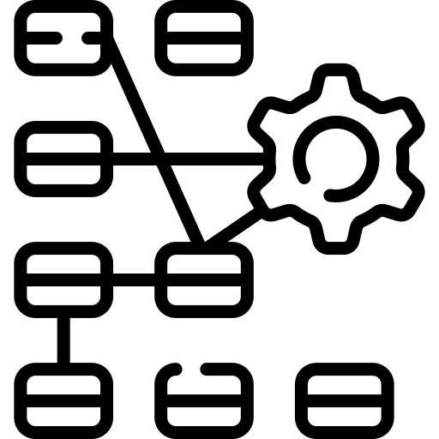
Key Discoveries
Single transactions driving major spend concentrations.
Clear seasonal procurement patterns requiring planning adjustments.
Operational complexity with 13 different movement types.

Slide 12
From Reactive to Data-Driven Procurement
Immediate Value Delivered
Cost Optimization: Unit price analysis reveals negotiation opportunities.
Risk Management: Supplier concentration and quality performance tracking.
Quality Improvement: Systematic monitoring of reversal patterns.
Strategic Planning: Historical trends enable accurate forecasting.
Expected Business Transformation
5-15% cost reduction through data-driven negotiations.
Reduced quality issues through systematic supplier monitoring.
Improved budget accuracy using historical spending patterns.
Enhanced supplier relationships based on objective performance data.

Slide 13
Questions?
THANK YOU!!

